Slide 1











Slide 2
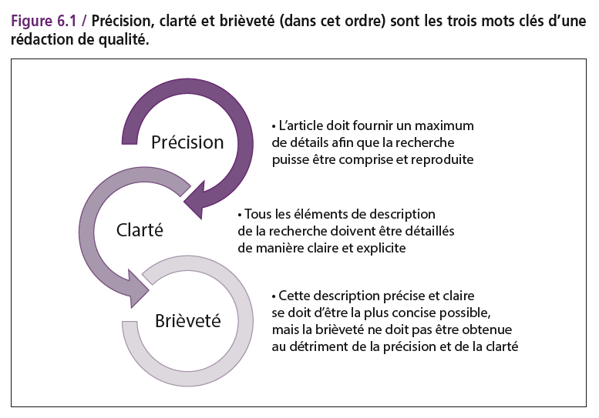

Slide 3
Elements of style
Start with your main point
Coherent paragraph
What not to say
Use simple language to describe complex ideas

Slide 4
Start with your main point

Slide 5
There is no central registry of veterans that identifies them as such, and not all veterans are counted by the Department of Veterans Affairs (VA) because only about 50 per cent of veterans ever register with the VA. The Department of Defense (DOD) and the US Centers for Disease Control and Prevention have partnered with the VA to share databases in an effort to more accurately estimate the number of veterans who commit suicide, but it’s still an imperfect system. The best estimate to date is that 22 veterans die by suicide daily, and more recent data suggest that the rate may be higher for veterans under the age of 30. For those still serving on active duty, DOD has more accurate count of suicide numbers because it investigates all of these events. Over the last decade, the number of suicides among service members slowly increased, hitting a high of 349 in 2012 and surpassing the number of service members lost in combat. The VA cannot accurately estimate the number of veterans who commit suicide without better data.

Slide 6
The Department of Veterans Affairs (VA) cannot accurately estimate the number of veterans who commit suicide without better data. There is no central registry of veterans that identifies them as such, and not all veterans are counted by the VA because only about 50 per cent of veterans ever register with the VA. The Department of Defense (DOD) and the US Centers for Disease Control and Prevention have partnered with the VA to share databases in an effort to more accurately estimate the number of veterans who commit suicide, but it’s still an imperfect system. The best estimate to date is that 22 veterans die by suicide daily, and more recent data suggest that the rate may be higher for veterans under the age of 30. For those still serving on active duty, DOD has more accurate count of suicide numbers because it investigates all of these events. Over the last decade, the number of suicides among service members slowly increased, hitting a high of 349 in 2012 and surpassing the number of service members lost in combat.

Slide 7
The Department of Veterans Affairs (VA) cannot accurately estimate the number of veterans who commit suicide without better data.
There is no central registry of veterans that identifies them as such, and not all veterans are counted by the VA because only about 50 per cent of veterans ever register with the VA. The Department of Defense (DOD) and the US Centers for Disease Control and Prevention have partnered with the VA to share databases in an effort to more accurately estimate the number of veterans who commit suicide, but it’s still an imperfect system. The best estimate to date is that 22 veterans die by suicide daily, and more recent data suggest that the rate may be higher for veterans under the age of 30. For those still serving on active duty, DOD has more accurate count of suicide numbers because it investigates all of these events. Over the last decade, the number of suicides among service members slowly increased, hitting a high of 349 in 2012 and surpassing the number of service members lost in combat.
Main point
Discussion of data and evidence
Illustration of a deductive structure

Slide 8
Start with your main point
It applies to the paragraph
It applies to the sentence
It applies to the title

Slide 9
Coherent paragraph
Use repetition when it is needed for accuracy

Slide 10
What not to say: delete needless words
When possible, compress several words into a word or two
Draft: We are in a position to make a recommendation that will improve the program.
Revision: We can make a recommendation that will improve the program.
Further revision: We can recommend an improvement.

Slide 11
What not to say: delete needless words
When possible, compress several words into a word or two
Draft: In the event that the program fails to meet certain standards…..
Revision: If the program fails……

Slide 12
What not to say: delete needless words
Delete “double words”
Full and complete…
True and accurate…
Could and potentially…
Delete redundant modifiers
Final implies outcome, so…..……final outcome is redundant
Finish implies complete, so……..completely finish is redundant
Young juveniles… 7 am in the morning……

Slide 13
What not to say: delete needless words
Delete empty nouns and meaningless modifiers
Kind of, really, basically, practically, actually, virtually, generally, certain, particular, individual, various, different, specific,…
Avoid using adverbs as much as possible
Unnecessary adverbs muddy up a statement.
Intensifiers (completely, totally, absolutely) are the most frequent overused.

Slide 14
Nominalisation
Indeed a major impediment to the interpretability of microarray data is the current lack of comparability from laboratory to laboratory
Nominalised words: interpretability, comparability
Suggested edit: Interpreting microarray data is difficult because we cannot easily compare data among laboratories

Slide 15
Style: KISS
Keep it short and simple
Subject / Verb / Object
10 to 15 words per sentence
Use simple language to describe complex ideas

Slide 16
Style: KISS
Avoid double negatives
Don’t write a paper without rules for co-authors
Define rules for co-authors to write a paper
Avoid metaphors
Avoid euphemisms:
‘Passed away’ use ‘died’
Animals are not ‘sacrified’, they are ‘killed’
‘Mortal consequences’….. Use ‘death’
Active voice: ‘It was found that…’ say ‘I found that…..’

Slide 17
Tenses of verbs
Past tenses for facts that were observed: mostly all scientific data
Present tense for established knowledge:
’Streptomycin inhibits the growth of M tuberculosis…’
The Earth is round
Refer your own present work in the past tense

Slide 18
Tenses of verbs… never use future tenses
Introduction: past and present
Streptomycin is an antibiotic….
Methods: past
Streptomycin was tested against
Results: past
Growth of streptomycin was inhibited…
Discussion: past and present
M tuberculosis was most susceptible to streptomycin at ph 8.2. Various species are most susceptible to streptomycin (5,9)….

Slide 19
Style KISS
Numerals: it depends on your style manual
Spelling out numbers from one to nine and then numerals for 10 and followers
13 mL
Don’t use numerals to start a sentence: For hundred and ten patients had… and don’t start by 410
Abreviations are rare

Slide 20
Le meilleur style est l’absence de style
Précision
Clarté
Brièveté
Lisibilité (15 à 20 mots par phrase)

Slide 21
Le meilleur style est l’absence de style : la précision
Mots
Chiffres / totaux
Faits /opinions
Illustrations
Références

Slide 22
Le meilleur style est l’absence de style : la clarté
Position forte : début de phrase, de paragraphe, du titre…
Voix active
Pas de variation élégante
Temps des verbes : passé
Pas de double négation
Titres/légendes des illustrations

Slide 23
Le meilleur style est l’absence de style : la brièveté
Pas d’expressions émotionnelles
Enlever les bois morts
Peu d’adverbes
Abréviations ?
Pas d’ellipses

